Slide 1



DevSecOps at Supersonic Speed (well…getting there)
Project Lightning Rapid OFP 2021
SkiCAMP

Slide 2


INTRODUCTIONS
Derek “Eeyore” Bissinger Senior Software Architect 309th SWEG United States Air Force
Mike Snyder Client Principal - Defense Oteemo, Inc.
Notes:
Eeyore - a retired AF pilot, working as a government ser

Slide 3
NEED STATEMENT
How do you introduce DevSecOps to government?
Here is an example of small government led DevOps transformation that is successful
Cycle time to improve from Months to Hours
Build organizational capability almost entirely OJT and Peer Instruction provided by industry - working in partnership with industry and government
Lengthy, archaic, traditional processes for updating DoD software is not a new concept - getting capabilities into fighter jets still lags behind most industry standards
Notes:
Warfighters need updated OFP capabilities delivered at a pace that’s relevant to current operational objectives
Current OEM software supply chains are not agile enough to meet the Joint Force CC’s near-term operational needs
An agile government owned software supply chain that extends to hardware in the field would not require contract negotiation
This is part of a three-year effort to get to this point - where we met the warfighter requirement to turn and deploy code into a combat system within 24 hours, what once took months
- typical use case for the next war is the need to change an algorithm tomorrow to take advantage of some newly discovered fact today
- imagine the steps a major defense industry company would take? the truth is government process teams stand at the ready for this need given enough time
- what if the 24 hour need is in fact required for some future war?
- a government software supply chain built and approved for this speed of delivery is more important today than ever

Slide 4
DEFINITION OF TERMS
SWEG - Software Engineering Group (each of the three AF maintenance depots have one) - 309th, 76th, 402nd
OFP - Operational Flight Program (embedded system software)
Rapid OFP - a software supply chain that extends to embedded system hardware in the field with the capability to get updates in 24 hours or less
SDPE arrived and Lightning was the result
Notes:
- the 309th Software Engineering Group at Hill Air Force Base is just one of three similar teams found also at Tinker and Robbins AF bases
- we have specialized in writing AF embedded system software for over 30 years
- many of the systems were delivered to us by defense industry companies and we have the arduous task of maintaining and sometime re-engineering these systems over time
- the current development environment is heavy weight SDLC including contract negotiation with the original manufacturer that requires significant resource planning and execution of software changes
- a single line change of an algorithm on one day to the next founded on daily threat updates are usually rolled up to each incremental OFP release requiring complete system testing
- a rapid OFP delivery system relies on a daily OFP release schedule without compromising testing, accreditation, approval, and security

Slide 5
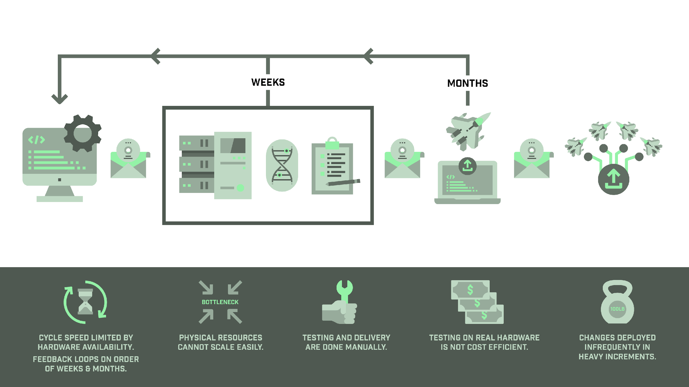
CURRENT PROCESS OVERVIEW
Systems Integration Lab
Mail to Systems
Integration Lab
Mail to
Test Center
Mail to
Operating Locations
Data Center
Test Against Hardware in Loop
Manual Testing
Load the Fleet On a
Depot- Driven Schedule
Developer Writes
Code in Local
Development Center
Remote Loader Device
Test On Actual Aircraft/Sensor
at $50K an Hour
Notes:
- as I have said the status quo in defense industry companies and the software engineering groups is not agile, at best it is agile waterfall
- tests are significantly manual, heck even the compilation process in most cases is significantly manual
- hardware tests are the only valid tests and while emulation or simulated tests are found everything still goes through a no kidding flight test
- lastly the landscape of AF embedded weapon systems are full of custom products and proprietary solutions without re-use or even of the shelf integration
- the conspirators out there laugh at vendor lock while the software engineers struggle with a mountain of legacy code languages and technical debt
- we are probably the only team in the AF asking the program offices to buy commercial and government off the shelf embedded hardware instead of paying a vendor to build yet another something new from scratch
- stick to known viable hardware architectures and hold the hardware manufacturer accountable to those standards
- we began this journey on May 14th, 2019 when our F-16 SPO program manager hosted a conference call with the newly appointed AF Chief Software Officer Mr. Chaillan
- three months later in August we took up residency in colorado springs working with the team that is now known as platform one
- three months later we were able to demo the first iteration of rapid OFP integration on the F-16 by running a single node k3s cluster on an existing embedded device
- what started out as a what if now sounded possible and this is when our journey began to get us where we are today

Slide 6
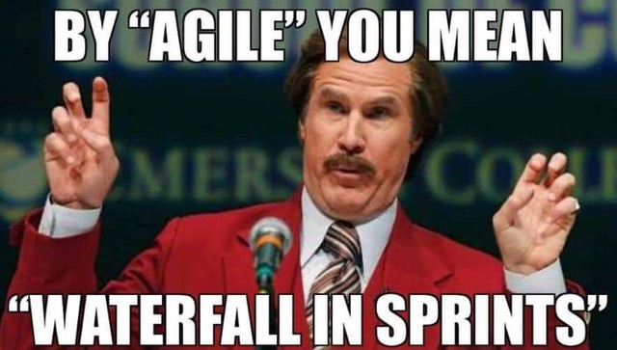
CHALLENGES TO START
OEM’s have traditionally controlled the SDLC and path-to-production for weapon systems and their embedded software
SWEG’s mission provides cradle-to-grave SW development and sustainment capabilities for aircraft, weapons, and cyber-physical platforms across the USAF operational fleets
NEED: An agile, government-owned, software supply chain that extends to hardware in the field would not require contract negotiation
Many teams (government and contractors) coming together to implement a proof-of-value without ever working together previously
Notes:
- the challenges our team encountered over time are considerable: they are entrenched process, established defense industry contracts, extensive program office management teams, all siloed within the known ways to do this
- the SWEG as a partner to facilitate the smooth transition of a weapon system from the vendor to the government has largely matched the corporate industry silos
- the team at project lightning wanted to see what a dev ops pipeline for our context would look like: a small team of government software engineers, assisted by a small team of corporate dev ops experts, working on a small microservice, delivered to a single embedded system, integrated with the rest of the jet OFP
- we created an independent software supply chain that could be released on a daily increment in a highly decoupled way to the rest of the OFP

Slide 7
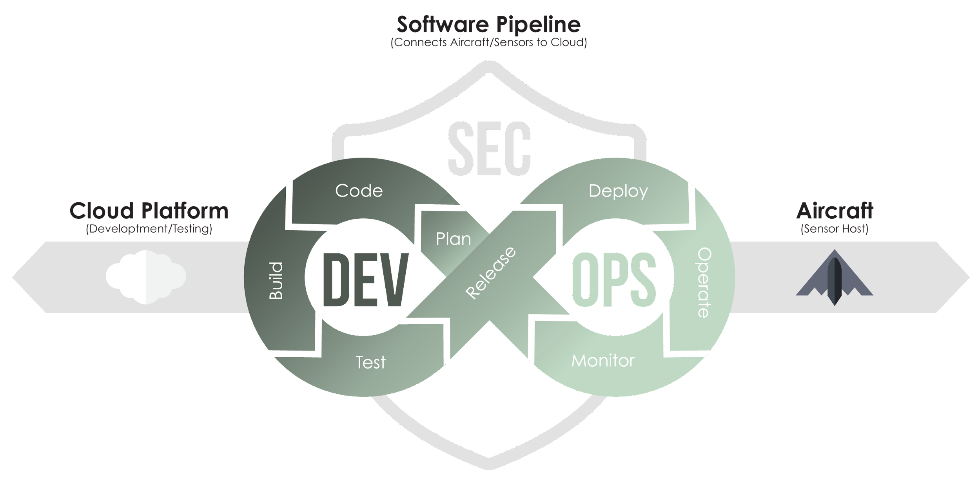
GOVERNMENT SOLUTION TENETS
Use Agile Software Development
Maximize Automation of Tests
Use and build trust in Digital Twins for Hardware Tests
Match Hardware Architecture Standards
Lightning is a Rapid OFP Delivery Pipeline Connecting the Cloud to the Jet
Notes:
- the challenges are so great on this journey we found it helpful to focus on four pillars to keep true to the course we believe is possible
- these appear reasonable at face value but the important story is what they rule out (next slide) - navigating the challenges and existing processes, while bringing in these core principles to stabilize the understanding of how new approaches will bring positive change vs. throwing out all the current state aspects that many programs and people are comfortable with

Slide 8
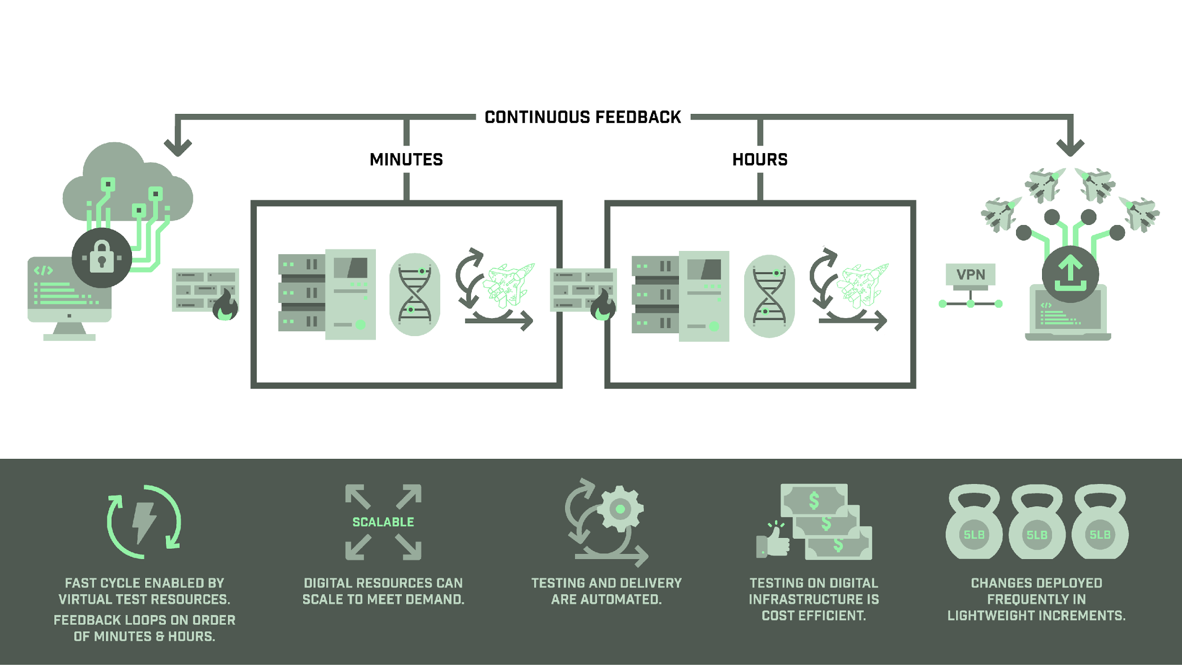

PROJECT LIGHTNING CONCEPT OVERVIEW
Lightning CI/CD Pipeline Connects Platform One to Aircraft/Sensors
Test On Digital Aircraft/Sensor
Encrypted
Firewall
Firewall
Developer Writes
Code in Local
Development Center
Sandbox
Data Center
Unclassified
Digital Twin #1
Automated
Testing
Stage
Data Center
Future Classified
Digital Twin #2
Automated
Testing
Load the Fleet On a
Operationally-Driven Schedule
Cross-domain Solution
Notes:
- fast forward almost two years and you see a vastly expanded framework for a Rapid OFP system we call project lightning, as in cloud to jet
- we are truly focused on agile software development principles
- we are using devops automation to automate integration, testing, accreditation, and secure delivery
- the necessity for extensive digital emulation testing has pushed us to various known hardware architecture standards
- we have found hardware does matter when digital twins are needed for the speed of testing and accreditation necessary for rapid OFP
- we depend on the security of container based applications to help bridge the multi-level security we have architected for
- we can justify the desire to classify context modularly and hopefully prevent moving everything up to the highest classification for the pipeline to work
- additional benefits have already been proven: we can deliver the same algorithm to more than one embedded system, by matching standard hardware architectures we can securely deliver a variety of real and non-real time container systems

Slide 9
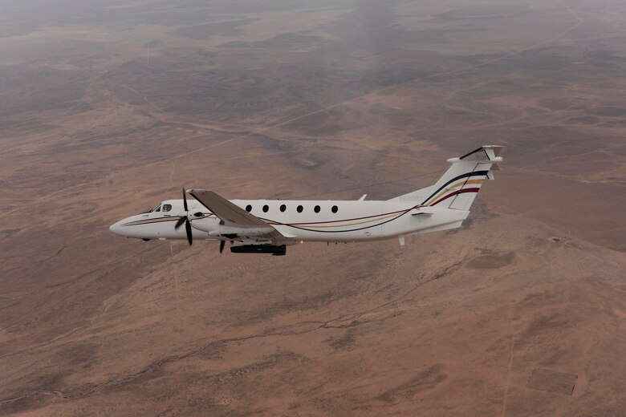
Delivering Proof of Value
SkiCAMP team working on the baseline on-prem infrastructure since Dec ‘20
April ‘21 multi-vendor team onboarded to support SkiCAMP; supported service blueprinting and
Cupcake -- Birthday Cake -- Wedding Cake assessment and planning
Established baselines for remote-access, SSO, test automation, and configuration of MANDO, GROGU, and integrated with OFP Dev Team
June ‘21 - Executed proof of concept during the USAF flight test event: deployed baseline OFP to aircraft pod at the beginning of the ATO day, received post-mission data, updated OFP code, tested, and deployed updates to flight that night
Notes:
Mike’s Slide our latest demonstration in June resulted from our collaboration with a defense industry partner to closely integrate our deployable service on the aircraft platform with the vendor provided sensor pod
- the cabability to modify our service algorithms within 24 hours did not depend on either the aircraft platform or the sensor pod software release timelines
- this visibly demonstrated a future where each SWEG can maintain a government owned software supply chain that extends to hardware in the field
- this is not about taking the job of the OEM just more integration and more collaborative decision making but mostly independent release capability
- this is also not a one size fits all but rather a small microservice team that can provide a vital combat service as a portable reuseable secure and tested solution

Slide 10
CHALLENGES AHEAD
Desire to get to a regular flight test schedule
Continue to influence SWEG’s mission to provide cradle-to-grave SW development and sustainment capabilities for aircraft, weapons, and cyber-physical platforms across the USAF operational fleets
Continue to integrate with OEM’s SDLC and path-to-production
Continue to mature what we have started - need mission partners, organizational support, funding, and engineering team members
Scaling our combined team - government, military, and contractors to support the
Notes:
- our latest demonstration in June resulted from our collaboration with a defense industry partner to closely integrate our deployable service on the aircraft platform with the vendor provided sensor pod
- the cabability to modify our service algorithms within 24 hours did not depend on either the aircraft platform or the sensor pod software release timelines
- this visibly demonstrated a future where each SWEG can maintain a government owned software supply chain that extends to hardware in the field
- this is not about taking the job of the OEM just more integration and more collaborative decision making but mostly independent release capability
- this is also not a one size fits all but rather a small microservice team that can provide a vital combat service as a portable reuseable secure and tested solution

Slide 11

Looking to the Future
SkiCAMP

Slide 12
Questions?
Project Lightning Rapid OFP 2021
SkiCAMP

